Slide 1




Course code: CSE 443 Data structure and Algorithms (DSA Self paced)
Name : Lokhande Mahender
Registration no : 11809599
Section : K18NS

Slide 2
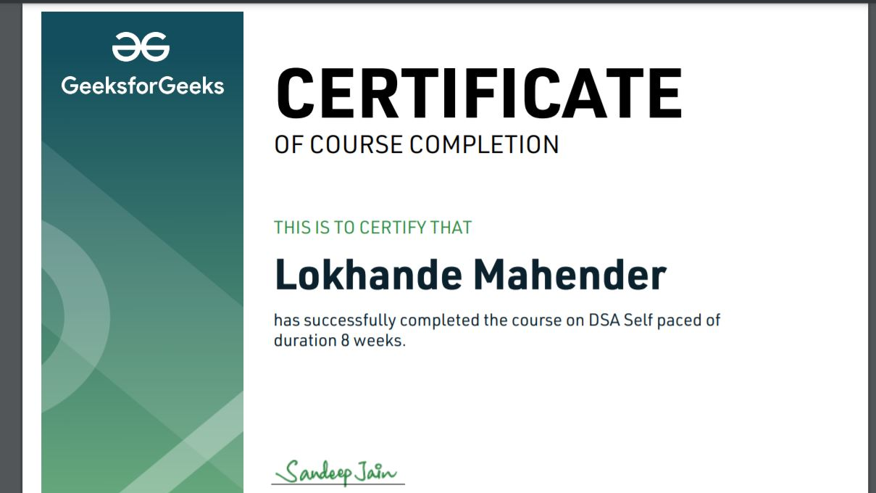

Slide 3
INTRODUCTION
DSA -Algorithm Basic
Searching Techniques
Sorting Techniques
Graph Data structure
Linked lists
Stack & Queue

Slide 4
INTRODUCTION
Arrays
Hashing
Strings
Binary Search Tree
Matrix

Slide 5
INTRODUCTION
Recursion
Heap
Disjoint Set
Mathematics tools
Bit Magic

Slide 6
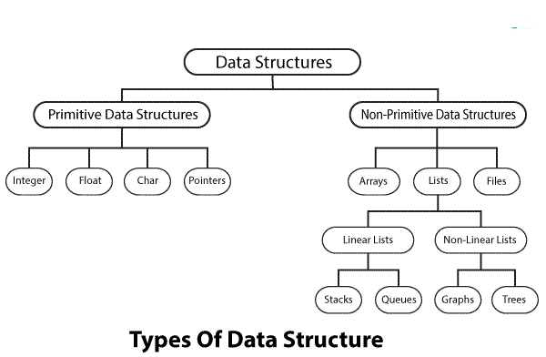
DSA –Algorithm basics
Data Type:
Data type is a way to classify various types of data such as integer, string, etc. which determines the values that can be used with the corresponding type of data, the type of operations that can be performed on the corresponding type of data. There are two data types
Built-in Data Type
Derived Data Type
Built-in Data Type:
Those data types for which a language has built-in support are known as Built-in Data types. For example, most of the languages provide the following built-in data types.
• Integers • Boolean (true, false) • Floating (Decimal numbers) • Character and Strings

Slide 7
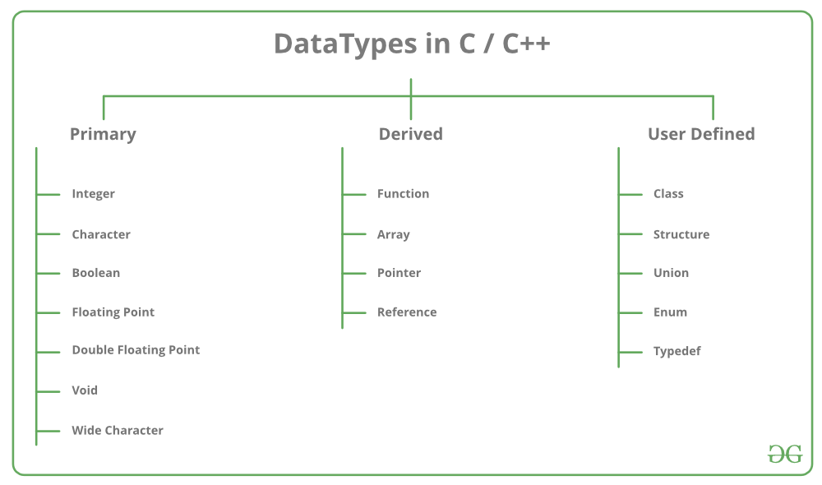
Derived Data Type:
Those data types which are implementation independent as they can be implemented in one or the other way are known as derived data types. These data types are normally built by the combination of primary or built-in data types and associated operations on them. For example −
• List
• Array
• Stack
• Queue
Basic Operations:
The particular data structure chosen largely depends on the frequency of the operation that needs to be performed on the data structure.
• Traversing • Searching • Insertion • Deletion • Sorting • Merging

Slide 8
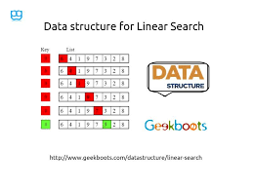
Searching Techniques
Linear Search:
Linear search is a very simple search algorithm. In this type of search, a sequential search is made over all items one by one. Every item is checked and if a match is found then that particular item is returned, otherwise the search continues till the end of the data collection Linear Search .
ALGORITHM
Step 1: Set i to 1 Complexity :: best case O(1) Average , Worst Case O(n)
Step 2: if i > n then go to step 7
Step 3: if A[i] = x then go to step 6
Step 4: Set i to i + 1
Step 5: Go to Step
2 Step 6: Print Element x Found at index i and go to step 8
Step 7: Print element not found
Step 8: Exit

Slide 9
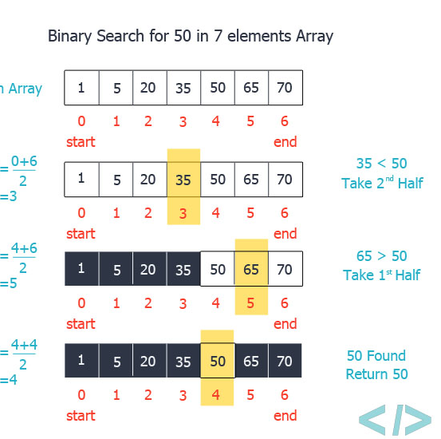
Binary Search
Binary search is a fast search algorithm with run-time complexity .This search algorithm works on the principle of divide and conquer. Binary search looks for a particular item by comparing the middle most item of the collection. If a match occurs, then the index of item is returned. If the middle item is greater than the item, then the item is searched in the sub-array to the left of the middle item. Otherwise, the item is searched for in the sub-array to the right of the middle item. This process continues on the sub-array as well until the size of the subarray reduces to zero.
we shall determine half of the array by using this formula :
Mid = low + (high - low) / 2
Complexity : best case O(1) Average Worst Case O(log n)

Slide 10
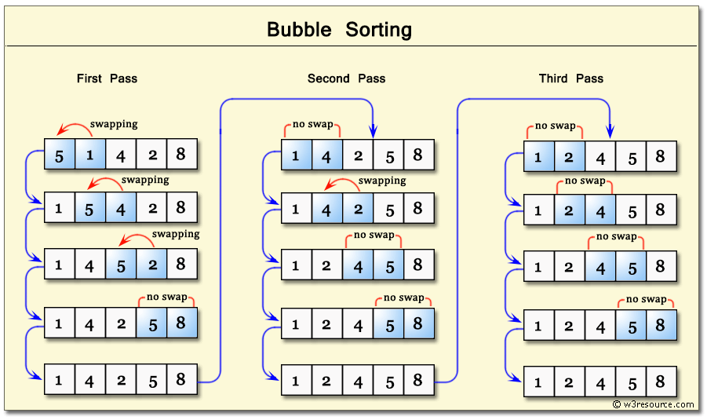
Sorting techniques
Bubble Sort :
Bubble sort is a simple sorting algorithm. This sorting algorithm is comparison-based algorithm in which each pair of adjacent elements is compared and the elements are swapped if they are not in order. Complexity : Best, Average,Worst Case O(n^2)
Algorithm
We assume list is an array of n elements. We further assume that swap function swaps the values of the given array elements.
begin BubbleSort(list)
for all elements of list if list[i] > list[i+1]
swap(list[i], list[i+1])
end if
end for
return list
end BubbleSort

Slide 11
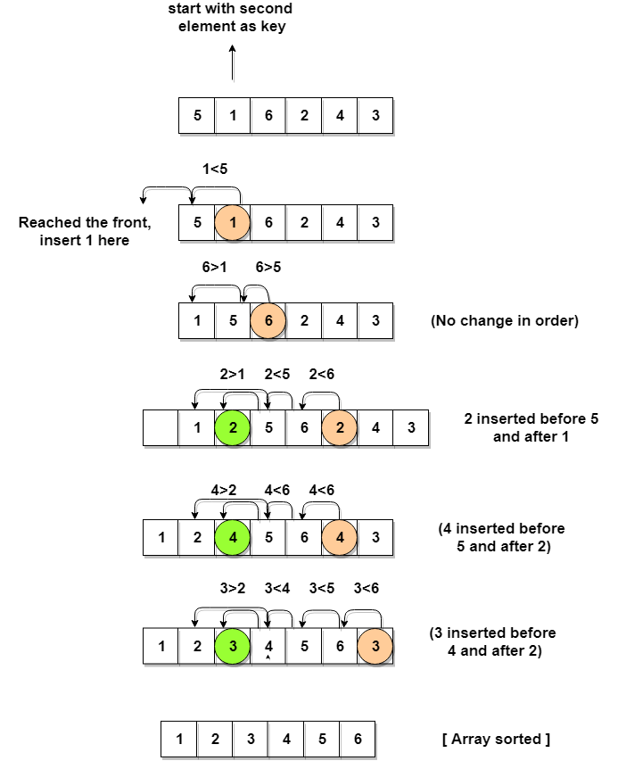
Insertion Sort :
This is an in-place comparison-based sorting algorithm. Here, a sub-list is maintained which is always sorted. For example, the lower part of an array is maintained to be sorted. An element which is to be 'insert'ed in this sorted sub-list, has to find its appropriate place and then it has to be inserted there. Hence the name, insertion sort. Complexity : Best, Average,Worst Case O(n^2).
Algorithm
Now we have a bigger picture of how this sorting technique works, so we can derive simple steps by which we can achieve insertion sort.
Step 1 − If it is the first element, it is already sorted. return 1;
Step 2 − Pick next element
Step 3 − Compare with all elements in the sorted sub-list
Step 4 − Shift all the elements in the sorted sub-list that is greater than the value to be sorted
Step 5 − Insert the value
Step 6 − Repeat until list is sorted

Slide 12
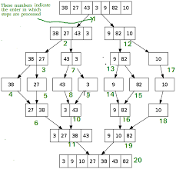
Merge Sort :
Merge sort is a sorting technique based on divide and conquer technique. Merge sort first divides the array into equal halves and then combines them in a sorted manner.Complexity :
Best, Average,Worst Case is O(N.logN)
Merge sort keeps on dividing the list into equal halves until it can no more be divided. By definition, if it is only one element in the list, it is sorted. Then, merge sort combines the smaller sorted lists keeping the new list sorted too.
Step 1 − if it is only one element in the list it is already sorted, return.
Step 2 − divide the list recursively into two halves until it can no more be divided.
Step 3 − merge the smaller lists into new list in sorted order.

Slide 13
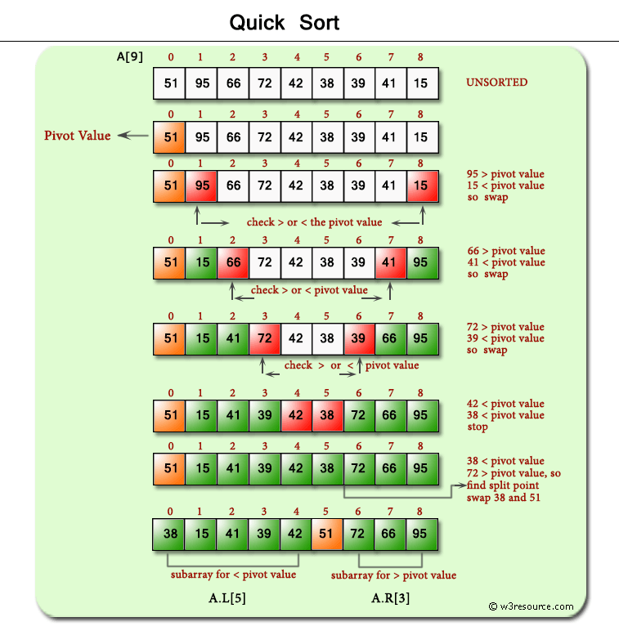
Quick Sort
Quick sort is a highly efficient sorting algorithm and is based on partitioning of array of data into smaller arrays. A large array is partitioned into two arrays one of which holds values smaller than the specified value, say pivot, based on which the partition is made and another array holds values greater than the pivot value . Quicksort partitions an array and then calls itself recursively twice to sort the two resulting sub arrays . This algorithm is quite efficient for large-sized data sets as its average and worst-case complexity are O(nLogn) and O(n2), respectively.
Quick Sort Pivot Algorithm: Based on our understanding of partitioning in quick sort, we will now try to write an algorithm for it, which is as follows.
Step 1 − Choose the highest index value has pivot
Step 2 − Take two variables to point left and right of the list excluding pivot
Step 3 − left points to the low index
Step 4 − right points to the high
Step 5 − while value at left is less than pivot move right
Step 6 − while value at right is greater than pivot move left
Step 7 − if both step 5 and step 6 does not match swap left and right
Step 8 − if left ≥ right, the point where they met is new pivot

Slide 14
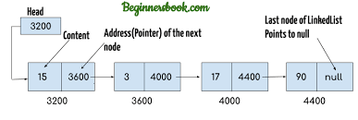
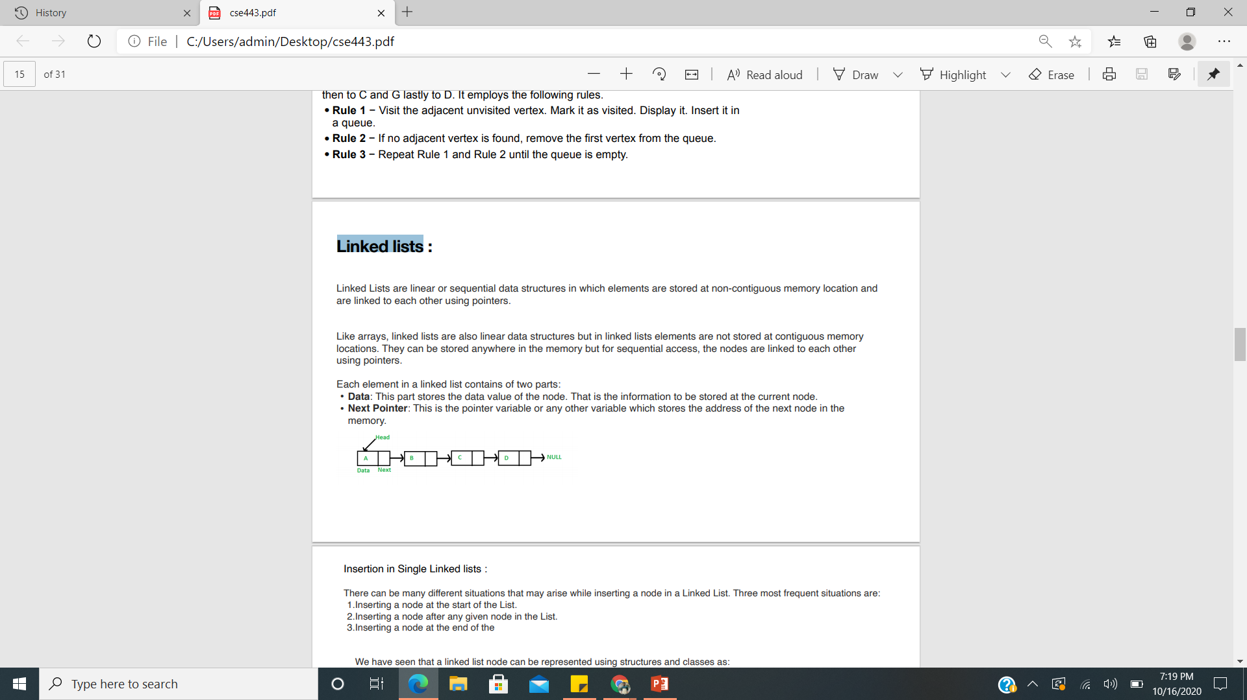
Linked lists
Linked Lists are linear or sequential data structures in which elements are stored at non-contiguous memory location and are linked to each other using pointers.
Like arrays, linked lists are also linear data structures but in linked lists elements are not stored at contiguous memory locations. They can be stored anywhere in the memory but for sequential access, the nodes are linked to each other using pointers.
Each element in a linked list contains of two parts:
• Data: This part stores the data value of the node. That is the information to be stored at the current node.
• Next Pointer: This is the pointer variable or any other variable which stores the address of the next node in the memory.

Slide 15
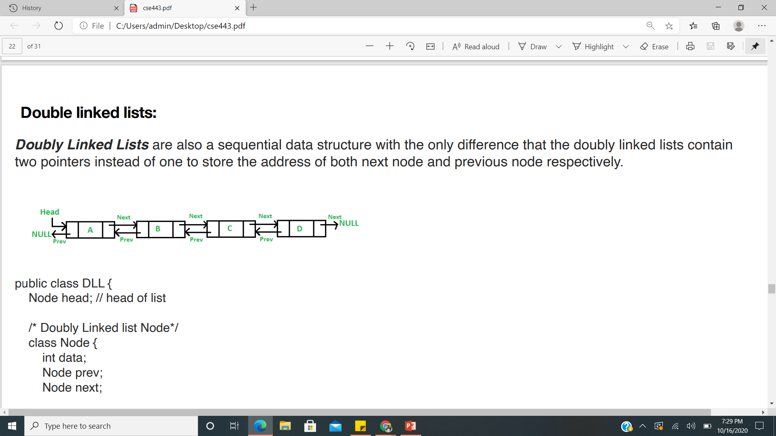
Double linked lists:
Doubly Linked Lists are also a sequential data structure with the only difference that the doubly linked lists contain two pointers instead of one to store the address of both next node and previous node respectively.
public class DLL {
Node head; // head of list
/* Doubly Linked list Node*/
class Node {
int data; Node prev;
Node next;
// Constructor to create a new node
// next and prev is by default initialized as null
Node(int d) { data = d; } } }

Slide 16
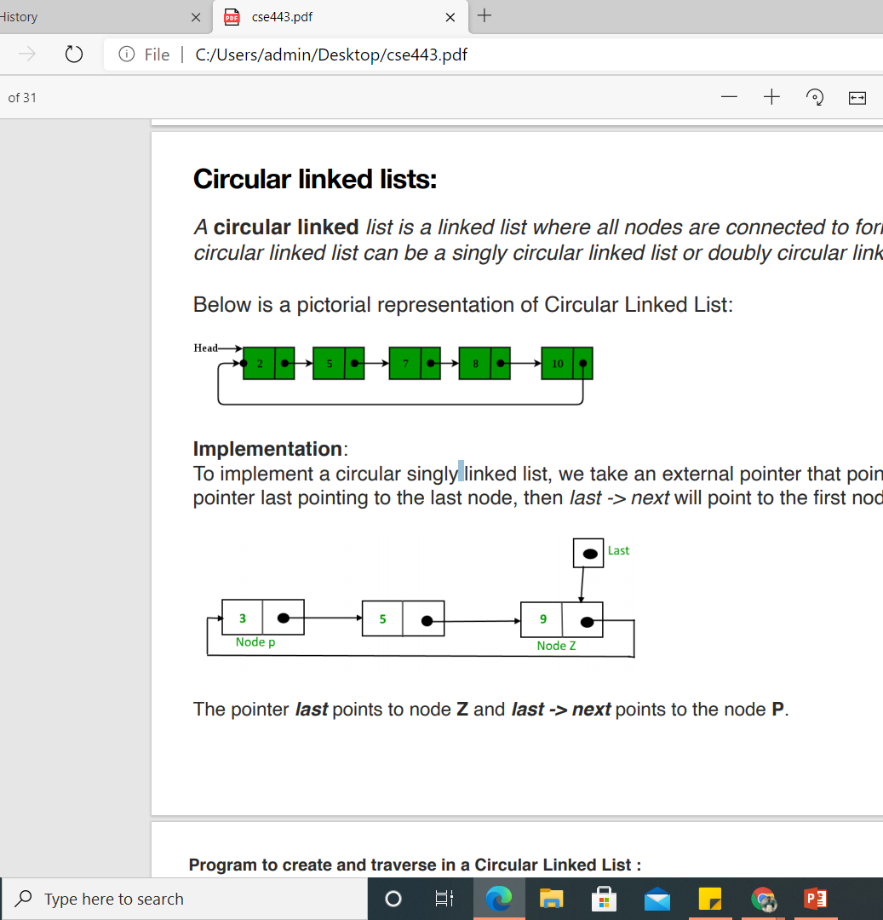
Circular linked lists:
A circular linked list is a linked list where all nodes are connected to form a circle. There is no NULL at the end. A circular linked list can be a singly circular linked list or doubly circular linked list.
Below is a pictorial representation of circular linked list:

Slide 17
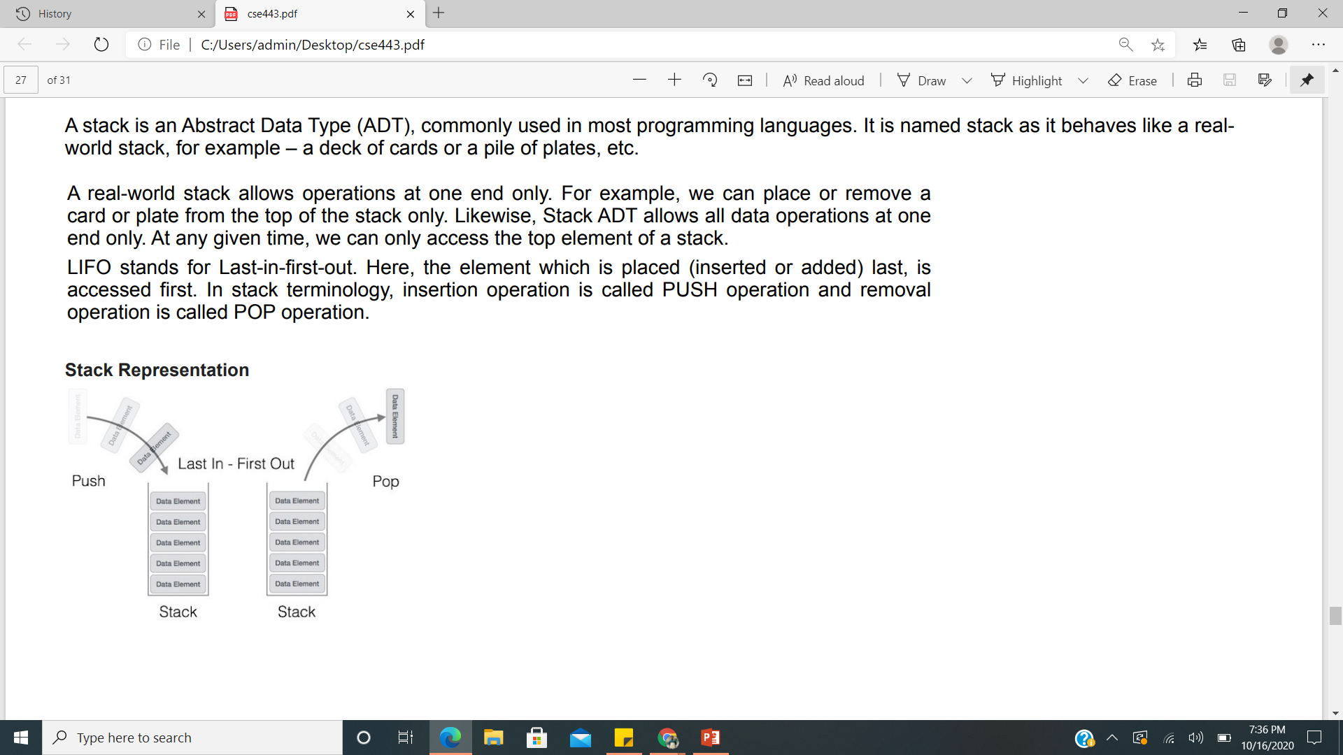
stack
A stack is an Abstract Data Type (ADT), commonly used in most programming languages. It is named stack as it behaves like a realworld stack, for example – a deck of cards or a pile of plates, etc.
A real-world stack allows operations at one end only. For example, we can place or remove a card or plate from the top of the stack only. Likewise, Stack ADT allows all data operations at one end only. At any given time, we can only access the top element of a stack.
LIFO stands for Last-in-first-out. Here, the element which is placed (inserted or added) last, is accessed first. In stack terminology, insertion operation is called PUSH operation and removal operation is called POP operation.

Slide 18
The way to write arithmetic expression is known as a notation. An arithmetic expression can be written in three different but equivalent notations, i.e., without changing the essence or output of an expression. These notations are −
• Infix Notation
• Prefix (Polish) Notation
• Postfix (Reverse-Polish) Notation These notations are named as how they use operator in expression. We shall learn the same here in this chapter.
Infix Notation
We write expression in infix notation, e.g. a - b + c, where operators are used inbetween operands. It is easy for us humans to read, write, and speak in infix notation but the same does not go well with computing devices. An algorithm to process infix notation could be difficult and costly in terms of time and space consumption.
Prefix Notation
In this notation, operator is prefixed to operands, i.e. operator is written ahead of operands. For example, +ab. This is equivalent to its infix notation a + b. Prefix notation is also known as Polish Notation.
Postfix Notation
This notation style is known as Reversed Polish Notation. In this notation style, the operator is postfixed to the operands i.e., the operator is written after the operands. For example, ab+. This is equivalent to its infix notation a + b.

Slide 19
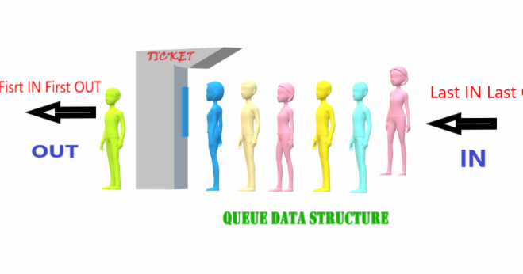
queue
Queue is an abstract data structure, some what similar to Stacks. Unlike stacks, a queue is open at both its ends. One end is always used to insert data (enqueue) and the other is used to remove data (dequeue). Queue follows First-In-First Out methodology, i.e., the data item stored first will be accessed first.
Basic Operations
Queue operations may involve initializing or defining the queue, utilizing it, and then completely erasing it from the memory. Here we shall try to understand the basic operations associated with queues −
• enqueue() − add (store) an item to the queue.
• dequeue() − remove (access) an item from the queue.
Few more functions are required to make the above-mentioned queue operation efficient. These are −
• peek() − Gets the element at the front of the queue without removing it.
• isfull() − Checks if the queue is full.
• isempty() − Checks if the queue is empty.

Slide 20
Hashing

Slide 21
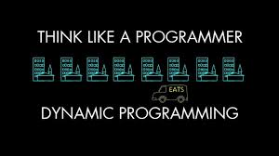
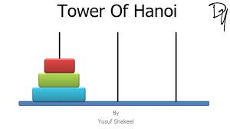
Dynamic programming
Dynamic programming approach is similar to divide and conquer in breaking down the problem into smaller and yet smaller possible sub-problems. But unlike, divide and conquer, these sub-problems are not solved independently. Rather, results of these smaller sub-problems are remembered and used for similar or overlapping sub-problems.
Dynamic programming is used where we have problems, which can be divided into similar sub-problems, so that their results can be re-used. Mostly, these algorithms are used for optimization. Before solving the in-hand sub-problem, dynamic algorithm will try to examine the results of the previously solved sub-problems. The solutions of sub-problems are combined in order to achieve the best solution.
So we can say that −
• The problem should be able to be divided into smaller overlapping sub-problem.
• An optimum solution can be achieved by using an optimum solution of smaller sub-problems.
• Dynamic algorithms use Memoization.

Slide 22
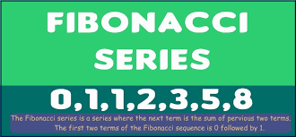
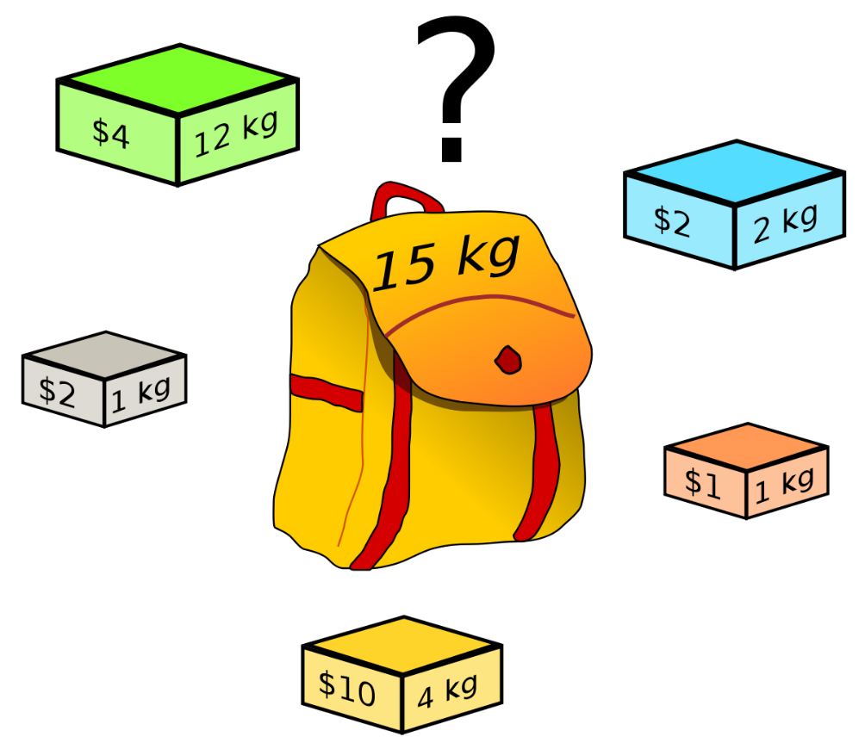
In contrast to greedy algorithms, where local optimization is addressed, dynamic algorithms are motivated for an overall optimization of the problem.
In contrast to divide and conquer algorithms, where solutions are combined to achieve an overall solution, dynamic algorithms use the output of a smaller sub-problem and then try to optimize a bigger sub-problem. Dynamic algorithms use Memorization to remember the output of already solved sub-problems.
Example
The following computer problems can be solved using dynamic programming approach −
• Fibonacci number series
• Knapsack problem
• Tower of Hanoi
• All pair shortest path by Floyd-Warshall
• Shortest path by Dijkstra
• Project scheduling

